Slide 1
Special Collections Introduction

Slide 2
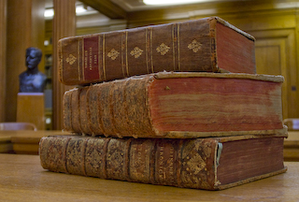
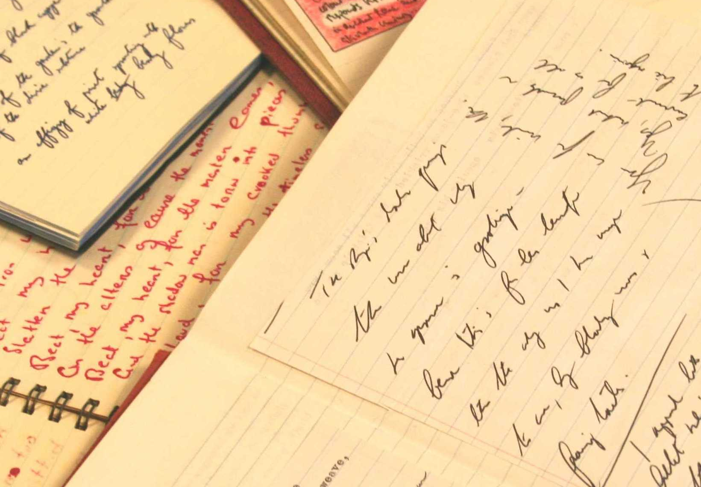
What is Special Collections?
Over quarter of a million books
Hundreds of thousands of manuscripts
Part of Leeds University Library
Notes:
A department within the University Library
One of the UK's outstanding collections of rare books and manuscripts:
• Over 200,000 rare books and hundreds of thousands of manuscripts and archives.
• People come from all over the world to use the material here.

Slide 3
Why use Special Collections?
Primary Sources
Unique to Leeds
Vast majority not digitised
Open to everyone
Notes:
Primary Sources gathered to support and promote research at the University of Leeds - Here for YOU.
Material in Special Collections that you won’t find anywhere else in the world.
Not even on google! Vast majority of our collections have not been – probably will never be digitised – important to remember when researching – not everything available online – you often have to dig deeper.
If you’re interested in something – we’ve probably got a collection to support it

Slide 4
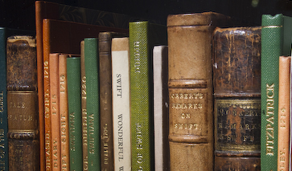
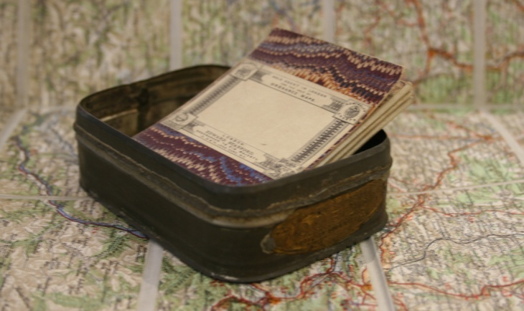
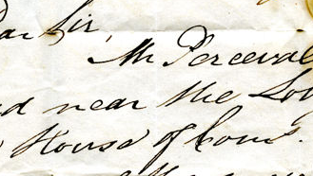
What do we have?
Outstanding national and international collections.
Home to the Institutional Archive of the University.
Notes:
Our 5 designated collections include:
English Literature
Liddle Collection (First & Second World War Material)
Romany Collection
Cookery Book Collection
Leeds Russian Archive.

Slide 5
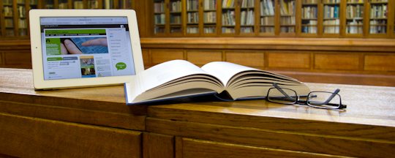
Using Special Collections: getting started
Notes:
Special Collections is open to everyone! You don’t even need to be a member of the University to visit.
Most researchers starting by using our webpages and catalogues to find the material they would like to use in Special Collections.
If you are interested in seeing an item, you can order it in advance by emailing us – we then retrieve items ready for your visit.
You can find lots of information about using Special Collections on our website.

Slide 6
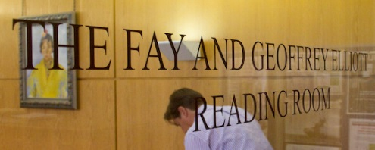
Using Special Collections: the Reading Room
Notes:
Consulting material in Special Collections is a different experience to what you might expect in other libraries.
The books and archives in Special Collections are often very old or fragile, so are not kept on open shelves.
Security can seem strict and we keep our collections in closed stacks that are climate-controlled.
Staff will be happy to advise you on how to use the catalogues and how to request items.
In the corridor outside Special Collections there is a row of lockers. For security and conservation reasons you will need to leave your bags and coats in one of these lockers.
Clear plastic bags are available if you want to take valuables into the reading room.
You can take in and use cameras and laptops and there are power points in the reading room and the group study areas. P
lease ring the bell and a member of staff will buzz you in. We will also show you how to handle items properly, so we can continue to make them available for as long as possible.
Special Collections staff will be happy to explain anything that might seem unclear.
They are there to help you get the most out of your visit!

Slide 7
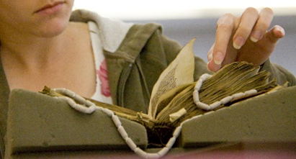
Using Special Collections: handling books and manuscripts
Notes:
Items can be very old, or very new, and we want all of them to be available to our researchers for many years to come.
Much of our material is fragile, and often irreplaceable, so we need to care for it in ways that ensure it can be accessed today and well into the future.
We offer guidance on how to handle the material and there are some basic rules we ask readers to follow.
Make sure you have clean hands, and minimise handling of items where possible.
We ask that you do not consume food or drink in Special Collections.
Please use only pencil for note-taking as accidents with ink can cause permanent damage.
Use the foam book supports and weights – staff will be happy to explain how to do this.
Keep loose documents in their original order and handle one at a time.
Close books when you are not using them.
Make sure you do not lean on books or manuscripts or rest objects on them.
Do not mark, annotate or deface the materials.
And finally, please tell us about any accidents or damage.

Slide 8
Using Special Collections: copying and digitisation
Notes:
You can take your own photographs of most of our material for your personal study and research.
Staff will be happy to explain any copyright issues.
Photocopying and digitisation services are also offered by Special Collections.
You can also find some images in our online catalogues along with links to our growing suite of digital learning resources. These combine high-quality images with informative text and explore items from the collections in more detail.

Slide 9
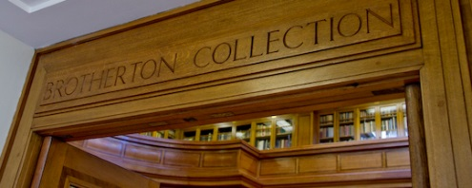
https://library.leeds.ac.uk/special-collections

