Slide 1
Special Collections Introduction

Slide 2
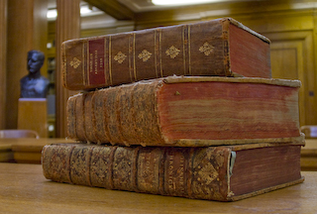
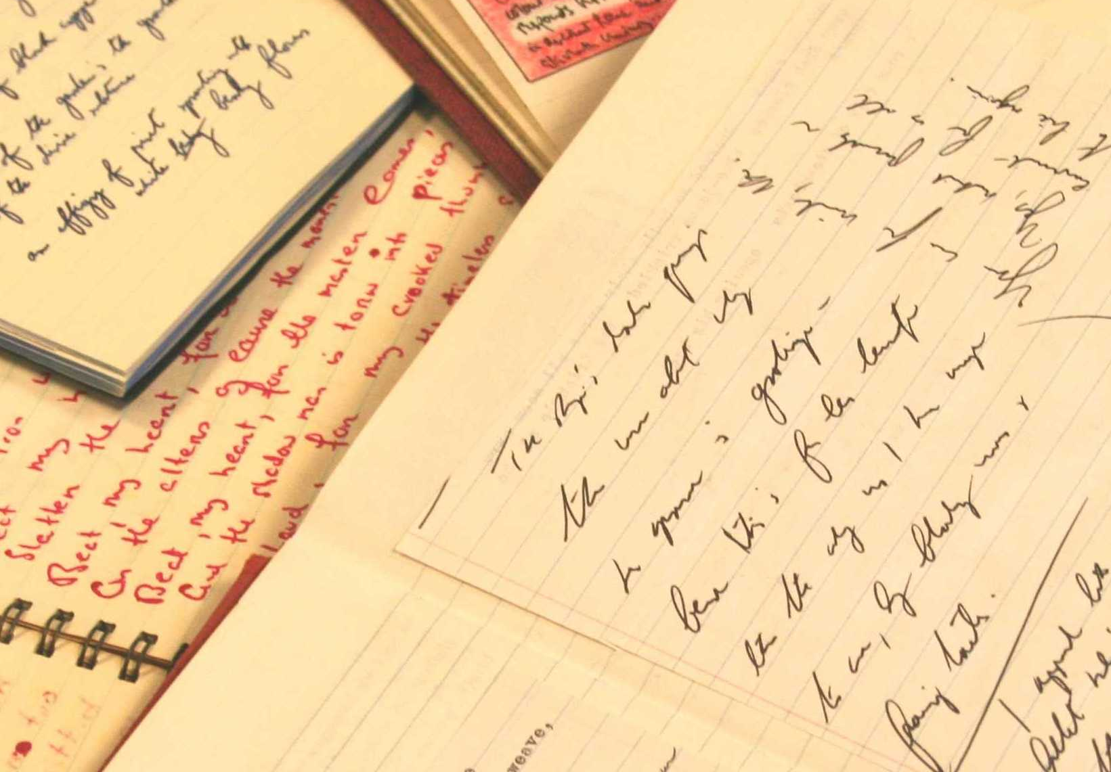
What is Special Collections?
Over quarter of a million books
Hundreds of thousands of manuscripts
Part of Leeds University Library
Notes:
A department within the University Library
One of the UK's outstanding collections of rare books and manuscripts:
• Over 200,000 rare books and hundreds of thousands of manuscripts and archives.
• People come from all over the world to use the material here.

Slide 3
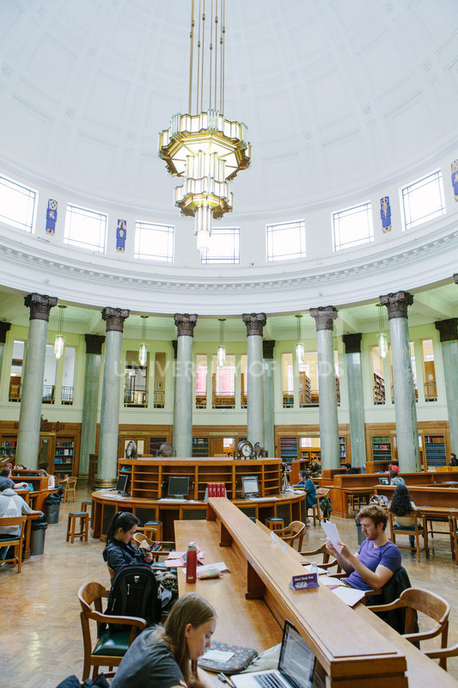
Leeds University Library
Over 2.8 million print & 500,000 online books, and more than 37,000 print and online journals.
4 main library sites:
Brotherton Library
Edward Boyle
Health Sciences Library
Laidlaw Library

Slide 4
Why use Special Collections?
Primary Sources
Unique to Leeds
Vast majority not digitised
Open to everyone
Notes:
Primary Sources gathered to support and promote research at the University of Leeds - Here for YOU.
Material in Special Collections that you won’t find anywhere else in the world.
Not even on google! Vast majority of our collections have not been – probably will never be digitised – important to remember when researching – not everything available online – you often have to dig deeper.
If you’re interested in something – we’ve probably got a collection to support it

Slide 5
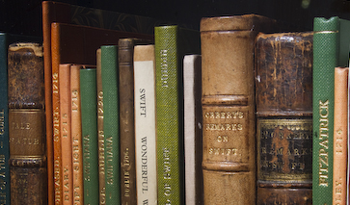
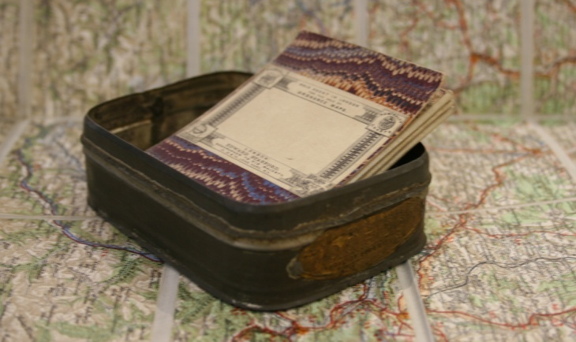
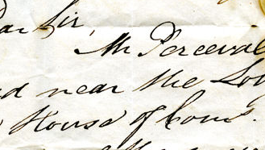
What do we have?
Designated status for outstanding national and international collections.
Home to the Institutional Archive of the University.

Slide 6
Designated English Literature Collection
Literary archives, manuscripts and books dating from 1600 to the present day.
Notes:
Literary Archives: Collection designated as of national & international importance.
Early printed & manuscript material – 16th – 17th- Centuries – includes Shakespeare first Folio, rare editions of Donne, Marvell.
18th Century – Brotherton Collection of Manuscript Verse
19th & 20th century novelists – amazing manuscripts and letters from the Brontes, Gaskell, Dickens, Byron, Wilde....Later material includes Greene, Waugh, O’Casey....
20th century poetry –focus on Leeds (&Yorkshire) Poets. Special Collections has one of the most important collections of modern literary papers in the country.

Slide 7
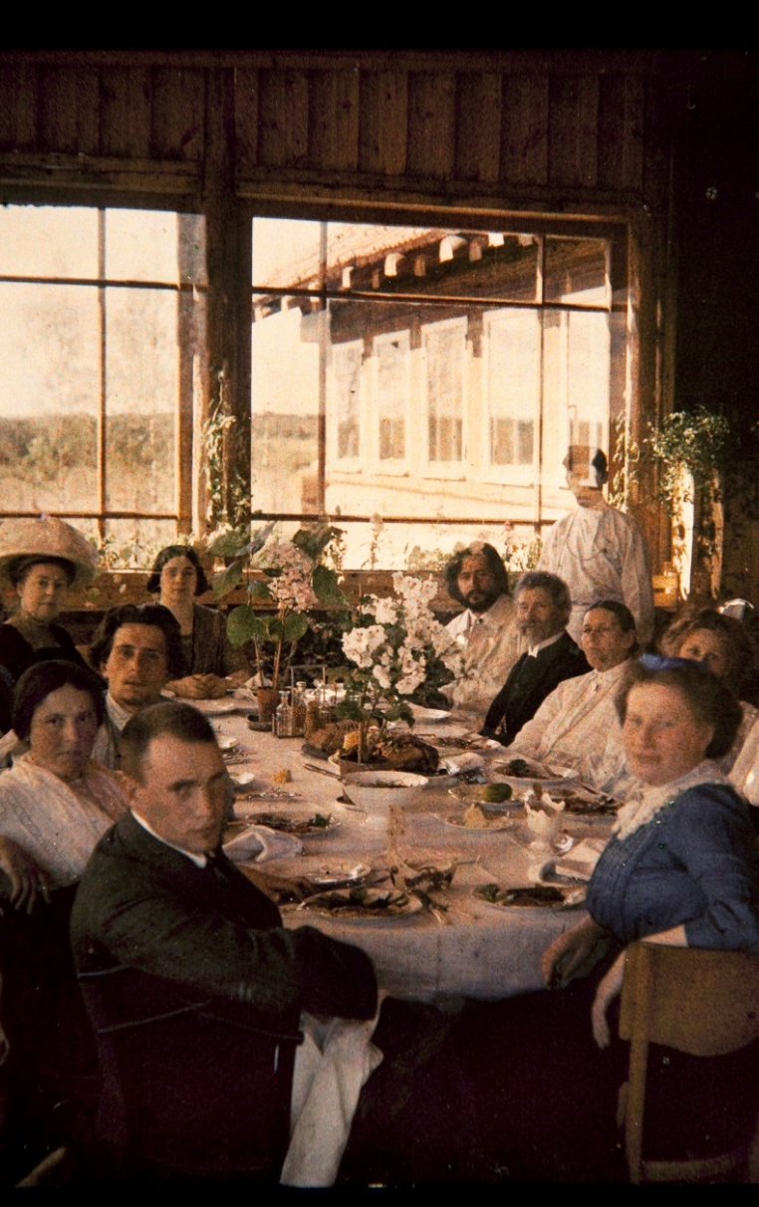
Designated Leeds Russian Archive
A major international resource for the study of Anglo-Russian relations in the 19th and 20th centuries.
Notes:
Established in 1982 and comprises:
650 collections of manuscripts, photographs and other archival material,
over 10,000 books, journals, newspapers and other printed matter
Collections document Anglo-Russian contacts in the nineteenth and twentieth centuries, including papers of members of the British community in Russia, travellers and diplomats, governesses and soldiers.
Notable British professional and other organisations are represented, such as the British Universities Association of Slavists, the National Association for Soviet and Eastern European Studies (that merged to form the British Association for Slavonic and East European Studies), the Association of Teachers of Russian and the Great Britain-USSR Association.
Collections document Russian and Russian emigre history, literature and culture, including the private, literary and other papers of Russian writers, notably Leonid Andreev (1871-1919) and Ivan Bunin (1870-1953), and the papers of the Russian railway engineer Yurii Lomonossoff (1876-1952), who occupied prominent positions under both the Tsarist and Bolshevik regimes.
The archive of the Paris-based Russian refugee organisation Zemgor is held.

Slide 8
Designated Liddle Collection
First-hand accounts of nearly 5,000 people who experienced the First and Second World Wars.
Notes:
The Liddle Collection, awarded Designation status, documents and preserves first-hand accounts of individuals who experienced the two World Wars. It was started privately in the early 1970s by the military historian Dr Peter Liddle and was established as part of Leeds University Special Collections in 1988.
It includes the personal papers of well over 4,000 people who lived through the First World War and over 500 who experienced the Second World War. It holds photographs and drawings, official and unofficial papers, manuscript diaries and correspondence.
The collection contains the papers of men and women directly affected by war, both those who were members of the armed forces and those who were not, and of British and non-British individuals alike.

Slide 9
Designated Cookery Collection
20,000 books and 600 manuscripts documenting the history of cookery and household management from the 15th century to the present day.
Notes:
The Cookery Collection, has its origins in 1,500 printed volumes and a number of manuscript volumes, presented to the Library by Blanche Leigh in 1939. It is made up of French and British works from 1487 to the 1930s. The collection was strengthened in 1962 by John F. Preston, gifting 600 printed volumes (British works before 1861).
The collection has continued to grow, with the acquisition of the Camden Library cookery collection (covering the later 20th Century) in the 1980s. The Michael Bateman print and archive collection was acquired in 2011.

Slide 10
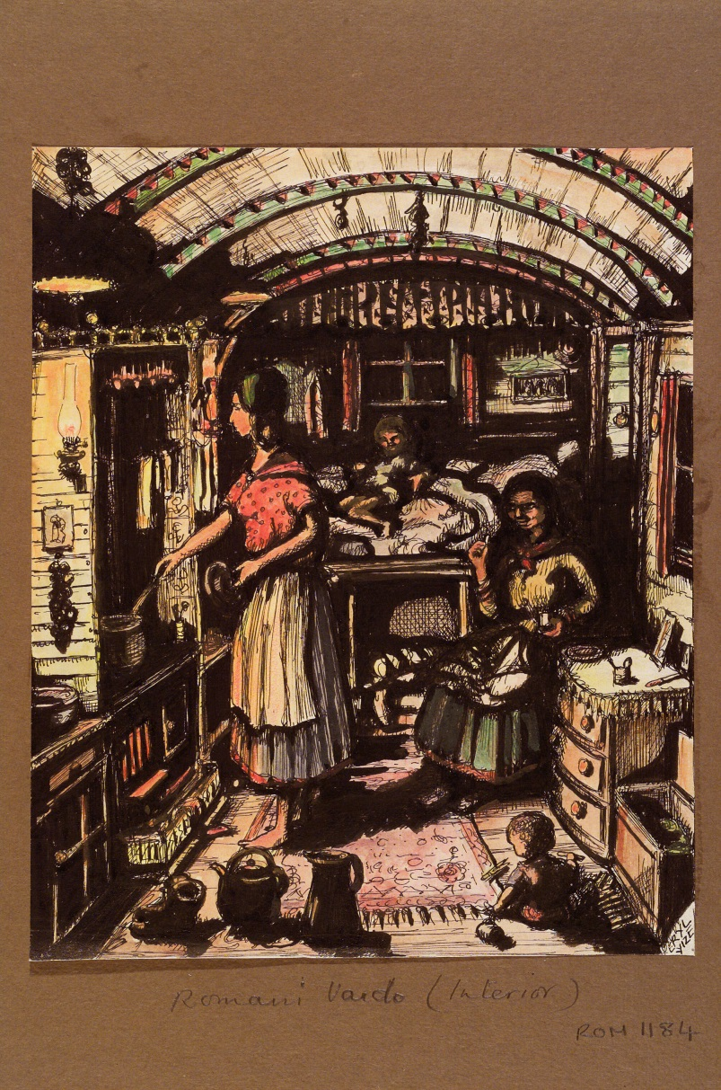
Designated Romany Collection
Substantial library and archive devoted to the history of Gypsies and related traveller groups.
Notes:
The Romany Collection has its origins in a collection assembled privately by Mrs D. U. McGrigor Phillips (niece of Lord Brotherton). It was presented by her to Leeds University Library in 1950, together with an endowment to fund its development.
In 2002 the collection grew significantly with the gift of Sir Angus Fraser's Gypsy library.
The collection includes virtually all the classic printed works on the Gypsies, both British and European, together with many more obscure items and, for comprehensiveness, some common ones. The outstanding manuscripts include a group of autograph Borrow drafts and notes for Lavengro, Romany Rye, Romano Lavo-lil and The Bible in Spain, T.W. Thompson's notebooks recording conversations with Gypsies and folktales told by them in the early 20th century and, later, archives of the National Gypsy Council.

Slide 11
What else have we got?
Business • Geography and travel • Science and medicine • Education • Music • Theatre & performance • Politics & social history • Yorkshire • Fine art & history of art • Religion and theology • Quaker • University Archive • Letters • Medieval manuscripts • 17th and 18th Century Manuscript Verse • Feminist Archive North • Incunabula • Leeds Archive of Vernacular Culture • Leeds General Cemetery • Medieval manuscripts
& much more…

Slide 12
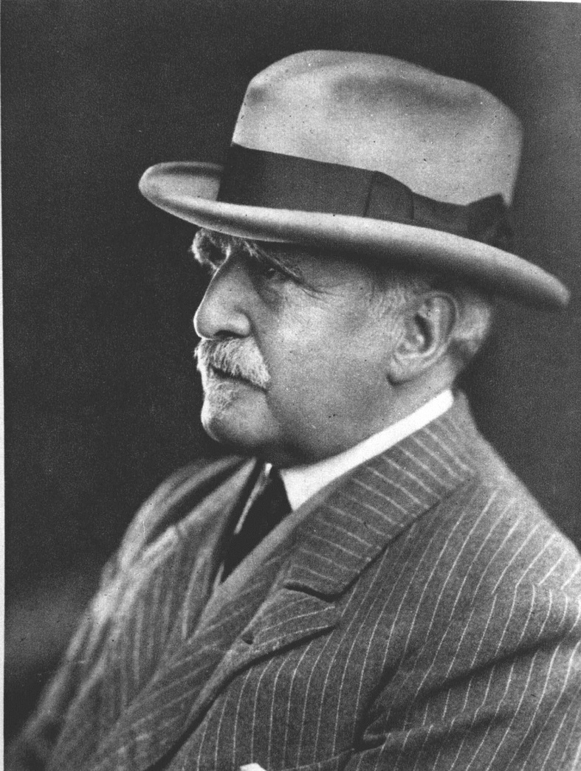
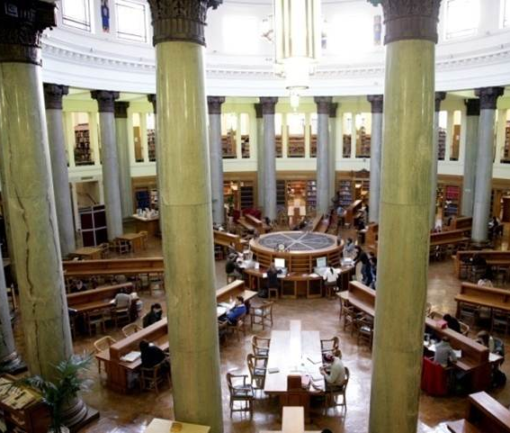
Special Collections History
Notes:
The Library's Special Collections owe almost everything to the generosity of several benefactors.
Such distinctive, unique and rare collections could never have been acquired and developed by relying on the conventional funding of a university library. They are the result of almost a century's worth of gifts, large and small, of many thousands of private individuals and groups.
The Brotherton Library itself was built by Lord Brotherton, who also left his collection of rare books and manuscripts, which form the core of Special Collections, to the University. His generosity did not stop there – he left an endowment which continues to provide an income allowing us to add to our collections.
In the 21st century Fay and Geoffrey Elliott have not only given books and manuscripts which would be the envy of any arts research library in the world, but have also provided substantial funding to secure significant additions.
Stanley and Audrey Burton are commemorated in the name of the University's Art Gallery, which, in its present splendid form, we owe to them entirely. The great majority of works on permanent display from the University's art collection are also gifts from them.
A new phase of benefaction is being nurtured by the University's current Fundraising Campaign. Special Collections is already benefitting from the generosity of Campaign supporters, who wish to enhance their predecessors' great collections even further while improving access to them in innovative ways.

Slide 13
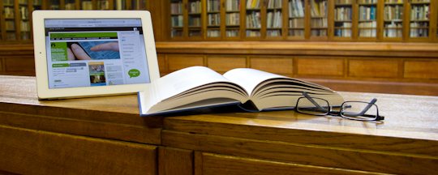
Using Special Collections: getting started
Notes:
Special Collections is open to everyone! You don’t even need to be a member of the University to visit.
Most researchers starting by using our webpages and catalogues to find the material they would like to use in Special Collections.
If you are interested in seeing an item, you can order it in advance by emailing us – we then retrieve items ready for your visit.
You can find lots of information about using Special Collections on our website.

Slide 14
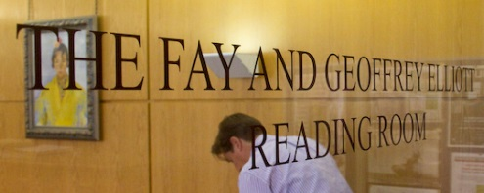
Using Special Collections: the Reading Room
Notes:
Consulting material in Special Collections is a different experience to what you might expect in other libraries.
The books and archives in Special Collections are often very old or fragile, so are not kept on open shelves.
Security can seem strict and we keep our collections in closed stacks that are climate-controlled.
Staff will be happy to advise you on how to use the catalogues and how to request items.
In the corridor outside Special Collections there is a row of lockers. For security and conservation reasons you will need to leave your bags and coats in one of these lockers.
Clear plastic bags are available if you want to take valuables into the reading room.
You can take in and use cameras and laptops and there are power points in the reading room and the group study areas. P
lease ring the bell and a member of staff will buzz you in. We will also show you how to handle items properly, so we can continue to make them available for as long as possible.
Special Collections staff will be happy to explain anything that might seem unclear.
They are there to help you get the most out of your visit!

Slide 15
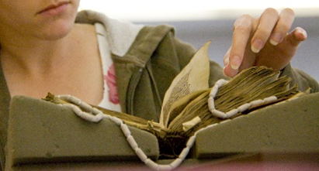
Using Special Collections: handling books and manuscripts
Notes:
Items can be very old, or very new, and we want all of them to be available to our researchers for many years to come.
Much of our material is fragile, and often irreplaceable, so we need to care for it in ways that ensure it can be accessed today and well into the future.
We offer guidance on how to handle the material and there are some basic rules we ask readers to follow.
Make sure you have clean hands, and minimise handling of items where possible.
We ask that you do not consume food or drink in Special Collections.
Please use only pencil for note-taking as accidents with ink can cause permanent damage.
Use the foam book supports and weights – staff will be happy to explain how to do this.
Keep loose documents in their original order and handle one at a time.
Close books when you are not using them.
Make sure you do not lean on books or manuscripts or rest objects on them.
Do not mark, annotate or deface the materials.
And finally, please tell us about any accidents or damage.

Slide 16
Using Special Collections: copying and digitisation
Notes:
You can take your own photographs of most of our material for your personal study and research.
Staff will be happy to explain any copyright issues.
Photocopying and digitisation services are also offered by Special Collections.
You can also find some images in our online catalogues along with links to our growing suite of digital learning resources. These combine high-quality images with informative text and explore items from the collections in more detail.

Slide 17
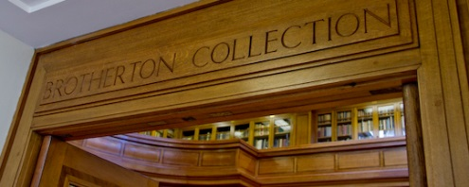
https://library.leeds.ac.uk/special-collections

